Slide 1
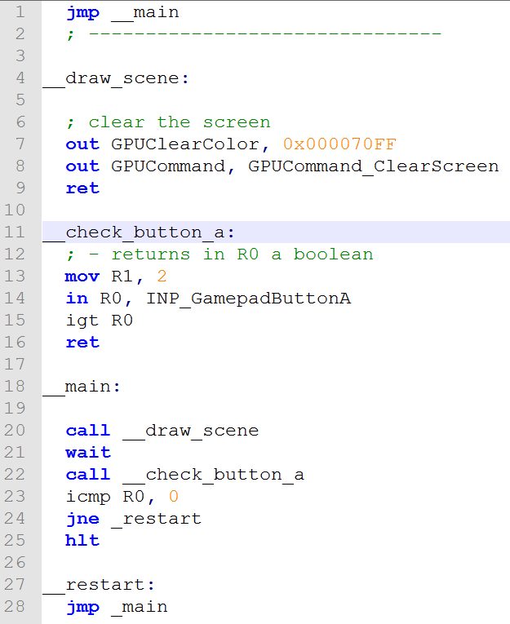




Program
ROM
Video
ROM
Audio
ROM
Instructions
+ Data
List of images
List of sounds
…
…
0
1
0
1

Slide 2



compile.exe
assemble.exe
VBIN

Slide 3




(import or convert
other files)
compile.exe
assemble.exe
VBIN
png2vircon.exe
packrom.exe
PNG
VTEX
wav2vircon.exe
WAV
VSND

